Slide 1
ALBERT: A LITE BERT FOR SELF-SUPERVISED LEARNING OF LANGUAGE REPRESENTATIONS
https://arxiv.org/pdf/1909.11942v6.pdf

Slide 2
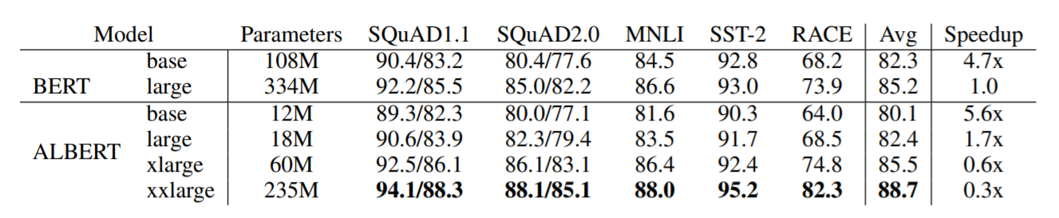
Overview
Albert: Smaller model size, faster training time, better performance
Model Optimization from 3 aspects
Factorized embedding parameterization
Cross-layer parameter sharing
Inter-sentence coherence loss

Slide 3
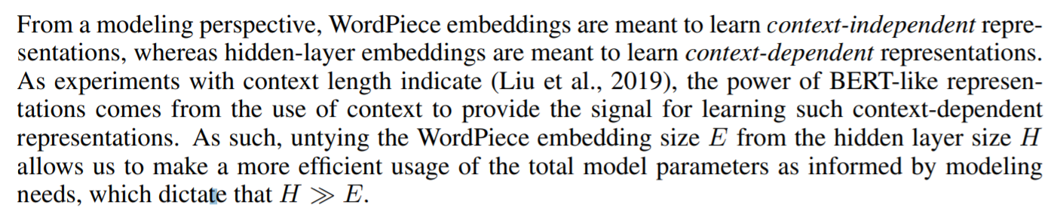
Factorized embedding parameterization

Slide 4
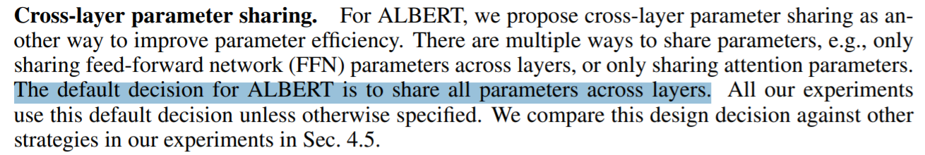
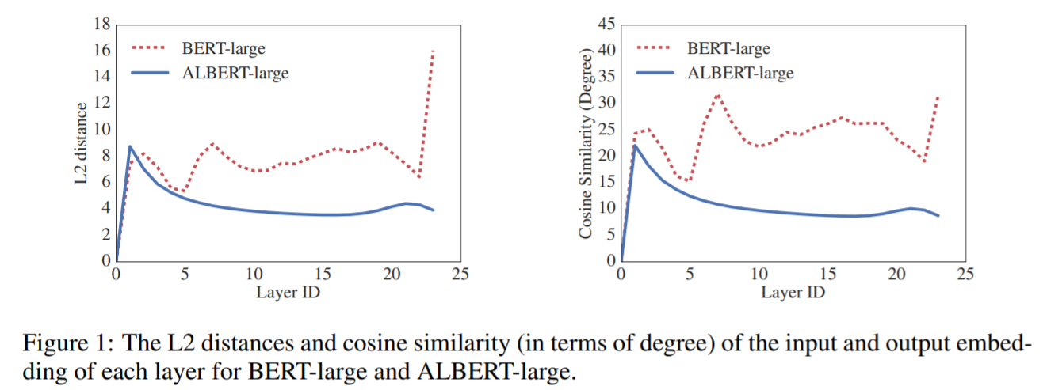
Cross-layer parameter sharing

Slide 5
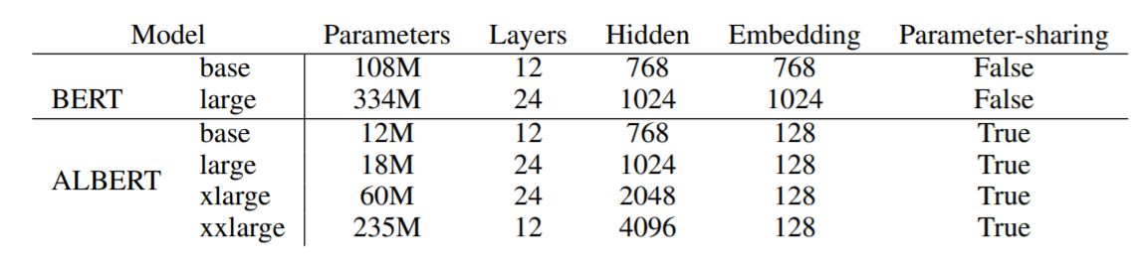
Inter-sentence coherence loss
We conjecture that the main reason behind NSP’s ineffectiveness is its lack of difficulty as a task, as compared to MLM. As formulated, NSP conflates topic prediction and coherence prediction in a single task2 . However, topic prediction is easier to learn compared to coherence prediction, and also overlaps more with what is learned using the MLM loss.
Parameter compare

Slide 6
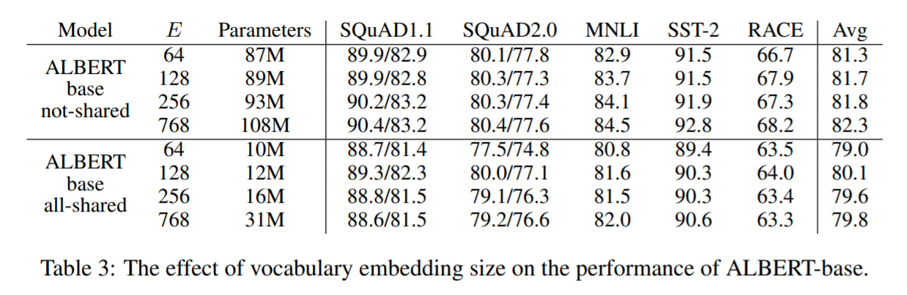
Experiment
Factorized embedding parameterization

Slide 7
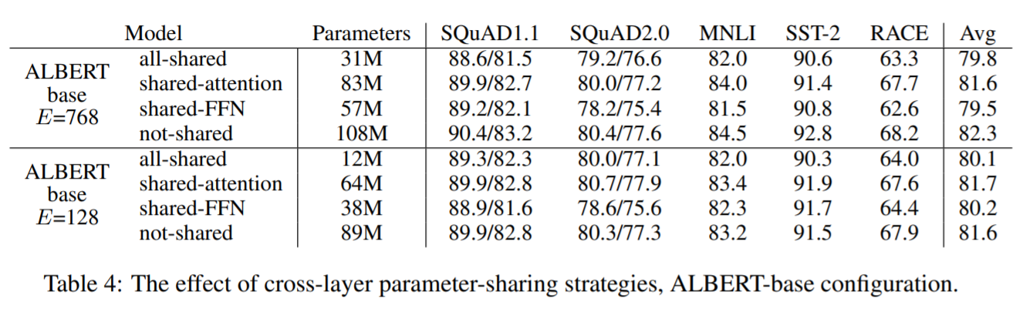
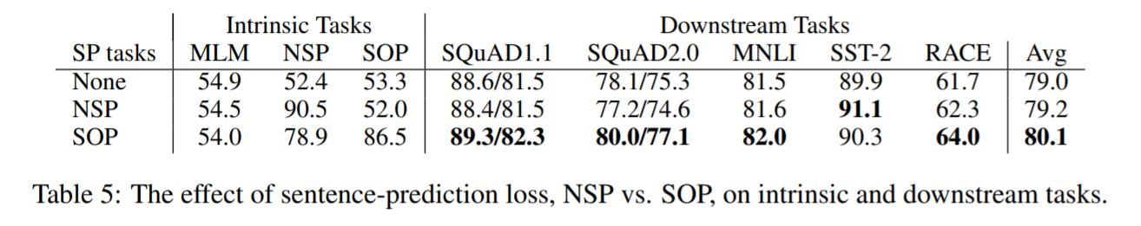
Experiment
Cross-layer parameter sharing
Inter-sentence coherence loss

Slide 8
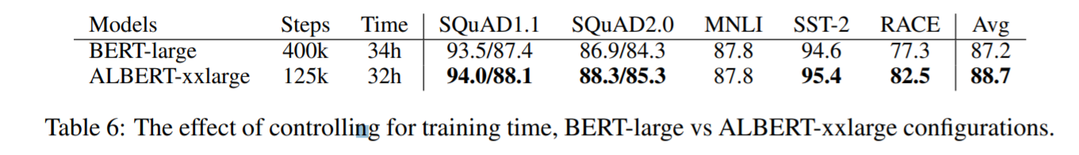
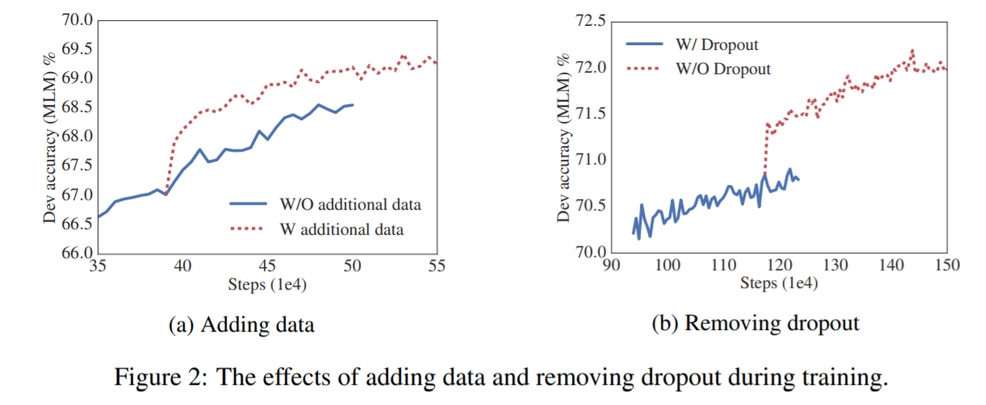
Experiment
WHAT IF WE TRAIN FOR THE SAME AMOUNT OF TIME?
ADDITIONAL TRAINING DATA AND DROPOUT EFFECTS

Slide 9
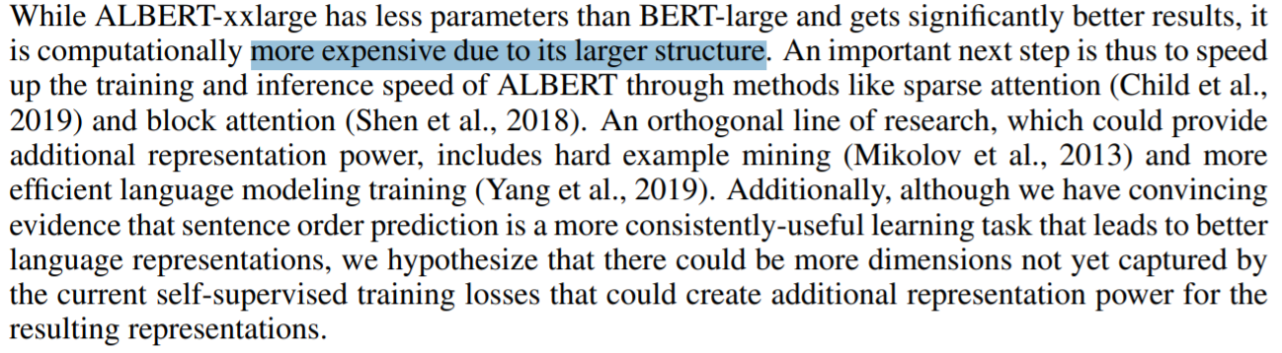
DISCUSSION

